Slide 1
INTRODUCTION TO HTML
THE CURVE

Slide 2
Scheme
(X)HTML terminology
Elements and tags
Attributes
Other terms you should know
Divs and spans
Block and inline elements
id and class attributes

Slide 3
CONTENTS
Brief History of HTML
How does the Web Work?
What is a Web Page?
My First HTML Page
Basic Tags
Headings and Paragraph

Slide 4
Brief History of HTML
Hypertext originally meant text stored in electronic form with cross-reference links between pages.
It now refers to just about any object (text, images, files, and so on) that can be linked to other objects.
Hypertext Markup Language is a language for describing how text, graphics, and files containing other information are organized and linked together.
Notes:
Until 1990, accessing information through the Internet was a rather technical
affair. It was so hard, in fact, that even Ph.D.-holding physicists were
often frustrated when trying to swap data. One such physicist, the now famous
(and knighted) Sir Tim Berners-Lee, cooked up a way to easily
cross-reference text on the Internet through hypertext links.
By 1993, only 100 or so computers throughout the world were equipped to
serve up HTML pages. Those interlinked pages were dubbed the World
Wide Web (WWW), and several web browser programs had been written to
allow people to view web pages.
Because of the growing popularity of the
Web, a few programmers soon wrote web browsers that could view graphical
images along with text. From that point forward, the continued development
of web browser software and the standardization of the HTML—
and XHTML—languages has lead us to the world we live in today, one in
which more than 110 million web servers answer requests for more than 25
billion text and multimedia files.

Slide 5
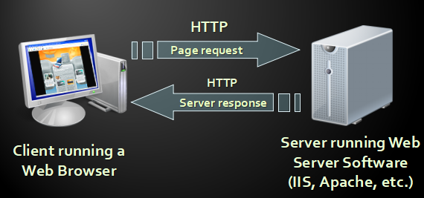
How does the Web Work?

Slide 6
What is a Web Page?
Web Page are text files containing HTML
HTML – Hyper Text Markup Language
A notation for describing
document structure (semantic markup)
Formatting (presentation markup)
Looks or Looked like:
A Microsoft Word document
The markup tags provide information about the page content structure.
Notes:
Markup: detailed stylistic instructions for typesetting something that is to be printed; manual markup is usually written on the copy (e.g. underlining words that are to be set in italics)

Slide 7
Creating an HTML Page
An HTML file must have .htm or .html file extension.
HTML files can be created with text editors:
NotePad, NotePad ++, PSPad e.t.c
Or HTML editors :
Microsoft FrontPage
Visual Studio
Microsoft Word

Slide 8
Basic Tags
HTML is comprised of “elements” and “tags”
Begins with <html> and ends with </html>
Elements are nested one inside another:
<html> <head></head> <body></body> </html>
Tags have attributes:
<img src=“logo.jpg” alt=“logo”/>
HTML describes structures using two main sections: <head> and <body>
Notes:
An element is a construct consisting (usually) of an opening tag, some optional attributes,
some content, and a closing tag. Elements can contain any number of further elements,
which are, in turn, made up of tags, attributes, and content. The following example shows
two elements: the <p> element, which is everything from the first opening angle bracket
(<) to the very last closing angle bracket (>), and the <em> element, which encompasses
the opening <em> tag, the closing </em> tag, and the content in between.
<p class="example">Here is some text, some of which is
<em>emphasized</em></p>.
A tag indicates the start and end of an element. The opening tag can contain multiple
attributes, but it cannot contain other elements or tags, while the closing tag cannot contain
anything but itself. In the preceding example, there are four tags: an opening <p>, an
opening <em>, a closing </em>, and a closing </p>.
Not all elements have closing tags. For example, <img>, <br>, <meta>, and <hr> are referred
to as self-closing elements, empty elements, or replaced elements. Such elements are
not container tags—that is, you would not write <hr>some content</hr> or <br>some content</
br>—and any content or formatting1 is dealt with via attribute values (see the next
section for more information). In HTML, a self-closing element is written simply as <img>,
<br>, <meta>, or <hr>. In XHTML, a self-closing element requires a space and a trailing slash,
such as <img />, <br />, <meta />, or <hr />.
Watch out for the <script> element: it is a container, so it has a required closing tag,
even though it can remain empty of content and uses the src attribute to reference
external scripts. This issue is made more complex by the fact that Opera (version 9 and
above) and Safari both support a self-closed <script>, so the element will work, but it
will remain invalid, and unsupported in other browsers.
Attributes appear within tags, and they can only contain the value of the attribute, for
instance:
<p class="example">Here is some text, some of which is
<em>emphasized</em></p>
This example shows the class attribute. An attribute can contain multiple, space-separated
values, which is useful if you need to apply different classes to one element. For instance, if
you have two styles, one named example and another named reference, you can apply
them both to a paragraph like so:
<p class="example reference">
Other attributes you may have already encountered might include alt, src, and title, but
there are many more attributes, some element-specific (like the selected attribute used
with the <option> tag) and some not (like the class and id attributes). If there is one thing
I want people to take away from this book, it is this: there is no such thing as an alt tag

Slide 9
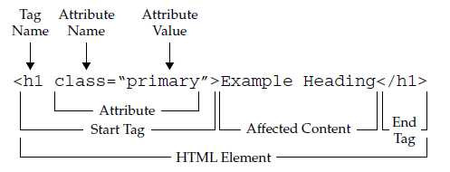
Overview of HTML markup Syntax

Slide 10
Important Tags in HTML
The <!DOCTYPE> statement, which indicates the particular version of HTML being used in the document.
The <html>, <head>, and <body> tag pairs are used to specify the general structure of the document.
The <meta> tag indicates the MIME type of the document and the character set in use.
Notes:
http://htmlref.com/ch1/html5helloworld.html

Slide 11
Tags Overview
The <title> and </title> tag pair specifies the title of the document, which generally appears in the title bar of the Web browser.
A comment is specified by <!-- -->, allowing page authors to provide notes for future reference.
The <h1> and </h1> header tag pair indicates a headline specifying some important information.

Slide 12
Tags Overview Contd
The <hr> tag, inserts a horizontal rule, or bar, across the screen.
The <p> and </p> paragraph tag pair indicates a paragraph of text.
The <em> and </em> tag pair surrounds a small piece of text to emphasize which a browser typically renders in italics.
Notes:
A special character is inserted using a named entity (&hearts;), which in this case inserts a heart dingbat character into the text.

Slide 13
The Document Head
is used to describe or augment the content of the document. The element acts like the front matter or cover page of a document. In many cases, the information contained within the head element is information about the page that is useful for visual styling, defining interactivity, setting the page title, and providing other useful information that describes or controls the document.

Slide 14
The Title Element
A single title element is required in the head element and is used to set the text that most browsers display in their title bar. The value within a title is also used in a browser’s history system, recorded when the page is bookmarked, and consulted by search engine robots to help determine page meaning. In short, it is pretty important to have a syntactically correct, descriptive, and appropriate page title. Thus, given <title>Simple HTML Title Example</title>

Slide 15
<meta>: Specifying Content Type, Character Set, and More
A <meta> tag has a number of uses. For example, it can be used to specify values that are equivalent to HTTP response headers. For example, if you want to make sure that your MIME type and character set for an English-based HTML document is set, you could use
<meta http-equiv="Content-Type" content="text/html; charset=ISO-8859-1">
Because meta is an empty element, you would use the trailing-slash syntax shown here:
<meta http-equiv="Content-Type" content="text/html; charset=ISO-8859-1" />

Slide 16
Most people would agree that using the UTF-8 character set is probably a good idea for Western-language page authors because it gives them access to international character glyphs when needed without causing them any trouble:
<meta http-equiv="Content-Type" content="text/html; charset=utf-8" >

Slide 17
<head>
<meta http-equiv="Content-Type" content="text/html; charset=utf-8" >
<title>Page title here</title>
</head>

Slide 18
ANY QUESTIONS?
Thanks For Listening

